Slide 1
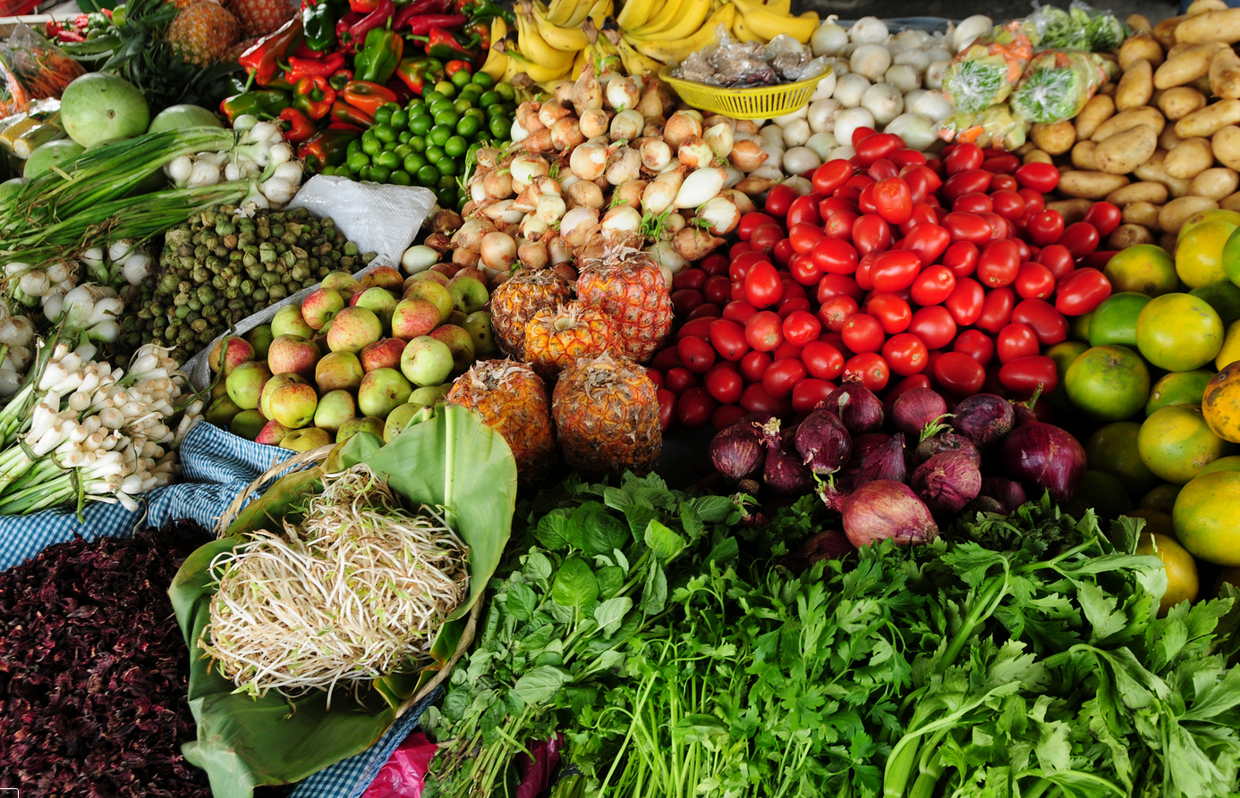
How (well) is food consumption measured in household surveys?
Olivier Dupriez, World Bank / IHSN New York, 1 March 2014

Slide 2
Acknowledgment
Lisa Smith (IHSN), Nathalie Troubat (FAO), and many contributors
Sponsors:
DFID Trust Fund Number TF011722, administered by the World Bank Data Group
World Bank Development Grant Facility, Grant Number 4001009-06, administered by the PARIS21 Secretariat at OECD

Slide 3
Objective
Improve the quality and use of food data collected in household consumption/expenditure surveys
Assess reliability and relevance from multiple stakeholder’s perspective, to identify issues and opportunities
Identify areas where research on methods is most needed to develop good practice
Sub-objective: harmonization of practices and increased comparability of data (not standardization of questionnaires)
Provide feedback and guidelines to producers and sponsors
Initiate a global initiative?

Slide 4
Understanding the users’ needs
Data are usually collected for a specific purpose/ stakeholder
Others re-purpose the data, with uneven success
What makes data reliable and relevant -- fit for purpose -- is specific to each use
Surveys can be made reliable and relevant for multiple purposes

Slide 5
Assessment approach
Step 1: Identify main categories of uses and users
Measuring poverty
Compiling national accounts
Calculating consumer price index
Assessing food security
Compiling food balance sheets
Informing nutrition interventions
Informing the private sector

Slide 6
Assessment approach
Step 2: Define criteria of reliability and relevance for each
Relevance: what is measured?
Reliability: how is it measured?
Step 3: Apply the criteria to 100 surveys
Desk review of questionnaires
No assessment of the data themselves
Assessment form + data + scripts are available at www.ihsn.org/home/node/34

Slide 7
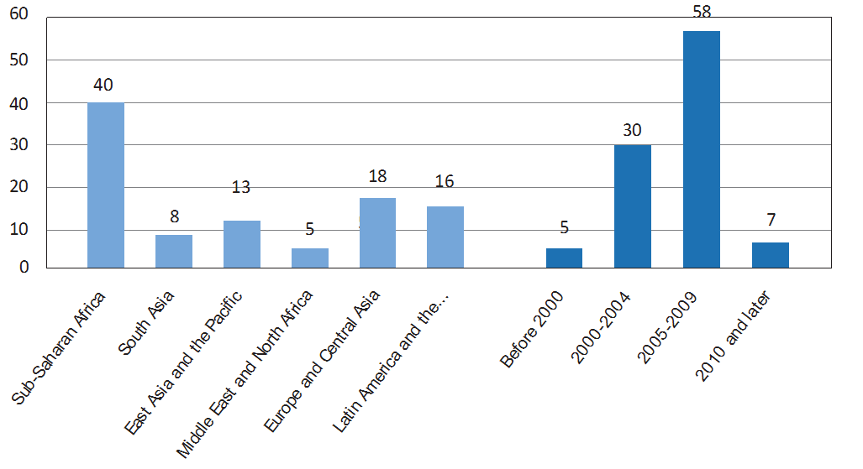
Sample of surveys
100 nationally-representative surveys of multiple types, from low and middle-income countries (1 per country)

Slide 8
Assessing reliability
Seven areas of investigation
Recall period for at-home food data collection
Modes of food acquisition included
Completeness of enumeration
Comprehensiveness of the at-home food list
Specificity of the at-home food list
Quality of data collected on food consumed away from home
Accounting for seasonality in food consumption

Slide 9
Reliability 1/7 – Recall period
Recall periods greater than two weeks (such as the “typical month”) would not provide accurate report of household consumption or expenditures.

Slide 10
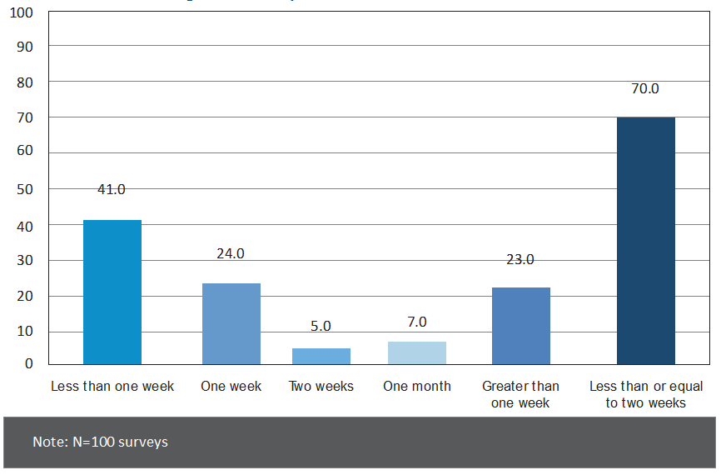
Reliability 1/7 – Recall period
70 %
= “Usual month”

Slide 11
Reliability 2/7 – Mode of acquisition
All surveys should collect data on:
food purchases (usually includes barter)
food consumed from own production
food received in kind
Wages in kind, social transfers in kind, gifts
Preferably individually on each source.

Slide 12
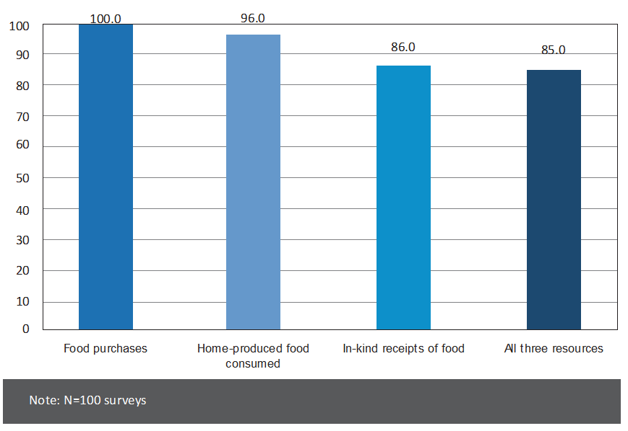
Reliability 2/7 – Mode of acquisition
85 %
Includes 14 that did not collect data individually for each one of the three methods.
71 %

Slide 13
Reliability 3/7 – Completeness
Incomplete enumeration may result from:
Not making a clear distinction between acquisition and consumption
Improper use of ruling questions
Ambiguity in the definition of “routine month”
Such issues were found in 25 percent of surveys

Slide 14
Reliability 4/7 – Comprehensiveness
Comprehensiveness of the at-home food list
Data must be collected on all of the types of food and beverages that make up the modern human diet. We judge the comprehensiveness of survey food lists using a set of 14 basic food groups.
Each basic food group must be represented by at least one item in the survey questionnaire.
At least 40 percent of products should be processed food items.
Food list should only include food commodities.

Slide 15
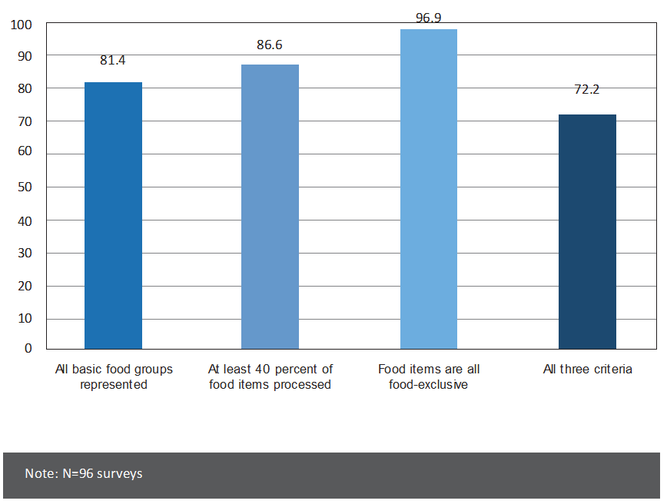
Reliability 4/7 – Comprehensiveness
72 %

Slide 16
Reliability 5/7 – Specificity of the list
Refers to the degree of detail with which food items (consumed at-home) are classified.
We identify a minimum number of food items that must be included in each basic food group
E.g., one for “Eggs”, 10 for “Fruits” or “Vegetables”
Some food groups are likely to be under-represented in some countries because the foods are not traditionally consumed by the population → minimum number to be met for at least 10 of the 14 food groups.
Food items should not span over two or more groups.

Slide 17
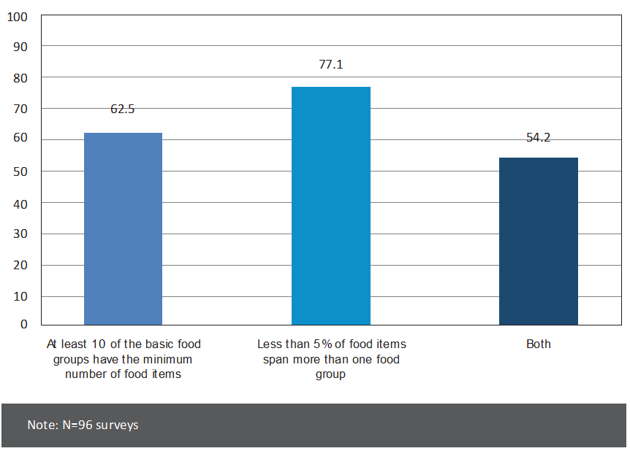
Reliability 5/7 – Specificity of the list
Specificity of the at-home food list
54 %

Slide 18
Reliability 6/7 – Food away from home
90 percent of surveys collected data on food away from home.
Only 23 percent collected data for multiple places of consumption.
Data were collected on (a small number of) specific food items for 33 percent of the surveys.
Data are collected at the individual level for 17 percent of the surveys.
The quality of data collected on food away from home is very low, despite evidence of the fast growing share of food away from home in household food consumption.

Slide 19
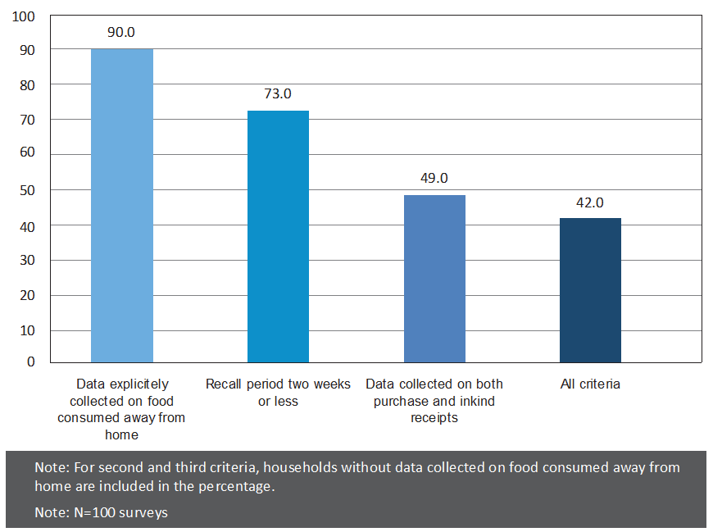
Reliability 6/7 – Food away from home
42 %

Slide 20
Reliability 6/7 – Food away from home
Egypt - Meals away from home:
20 percent in 1981
46 percent in 1998
India - % of households reporting consuming meals away from home:
23 percent in 1994
39 percent in 2010
Source: USDA website - http://www.ers.usda.gov/data-products/food-expenditures.aspx#.UwpVALSeuJ8

Slide 21
Reliability 7/7 – Seasonality
To account for seasonality:
Either multiple waves over 12 months (full sample 2 to 4 times a year), or
“Continuous” over 12 months (1/12th of the sample every month)
Only 53 percent of surveys take seasonality into account in a way that meets our criteria.

Slide 22
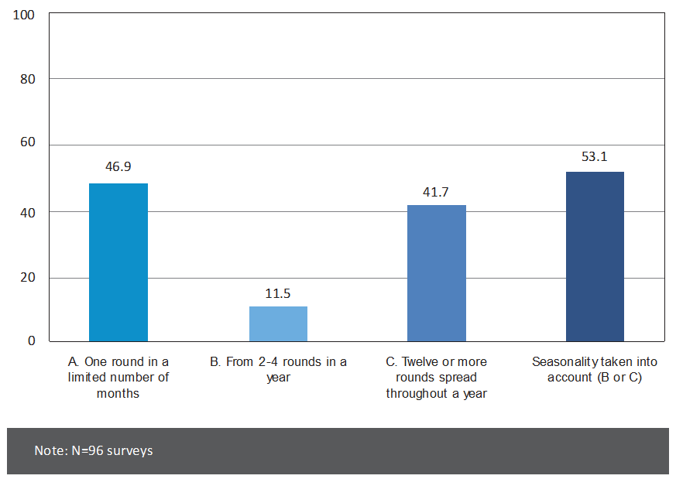
Reliability 7/7 – Seasonality
53 %

Slide 23
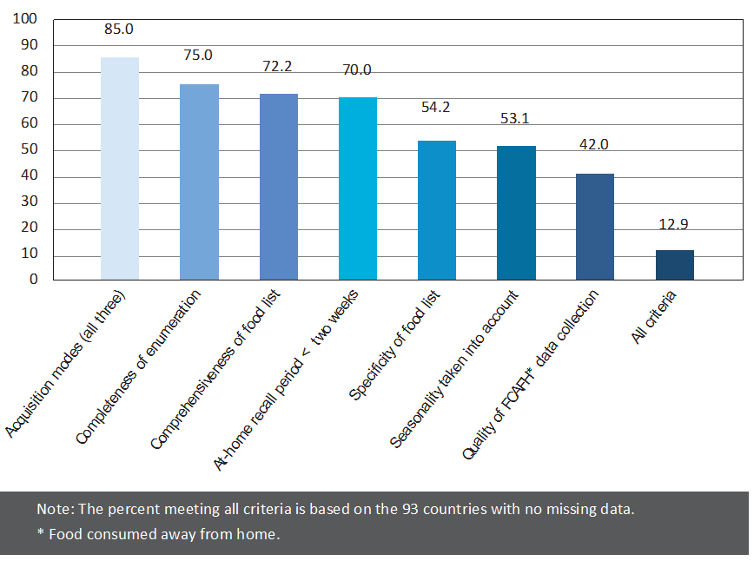
Reliability – Summary of 7 areas
13 %

Slide 24
Assessing relevance
We assess what indicators can be obtained from each survey.
Percent of households consuming individual foods
Percent of households purchasing individual foods
Percent of expenditures on individual foods/food groups
Expenditures on individual foods by source
Percent of total expenditures on food
Quantities consumed of individual foods
Calorie consumption and undernourishment
Calories consumed from individual foods/food groups
Protein and micronutrient consumption/insufficiencies
Dietary diversity
Estimating subsistence production
Consistency checks of FBS consumption patterns

Slide 25
Assessing relevance
Measuring quantities in standard measurement units is a significant issue.
Difficult to assess the situation, as the source of information is not necessarily found in the survey questionnaire
Importance to have (and publish!) national and sub-national unit conversion factors
Only 53 percent of surveys seem to satisfy the needs.

Slide 26
Relevance - Poverty
Roughly half of the surveys can be used for calculating poverty lines.
Detailed, spatially disaggregated price information, coupled with the issues related to accurately measuring calorie consumption, are the main constraining factors in employing HCES data for measuring poverty using the most well established methods.

Slide 27
Relevance – Food security
Calorie consumption and undernourishment (dietary quantity) can be measured for just under half of the surveys.
Accurate indicators of dietary quality is limited to a minority of surveys: when food consumed away from home is taken into account:
10 percent of the surveys can be used to calculate quantities consumed of individual foods,
9 percent for calculating macro and micronutrient consumption and insufficiencies,
9 percent for calculating the percent of expenditures on staples,
14 percent for calculating dietary diversity.
The measure of economic vulnerability to food insecurity—the percent of expenditures on food—can be calculated for 100 percent of the surveys.

Slide 28
Relevance – Food Balance Sheets
Close to half of all surveys can be employed for informing FBS in two important ways:
Providing consistency checks of per-capita dietary energy supply and undernourishment estimates
Estimating subsistence production of foods.
Near 20 percent of surveys can be used to provide consistency checks of FBS consumption patterns
10 percent can help estimate production of foods using estimates of the quantities of foods consumed

Slide 29
Relevance – Nutrition interventions
Informing food-based nutrition interventions: nearly all surveys can be used for measuring the percentage of households consuming and purchasing individual foods, an important piece of information needed for identifying fortifiable foods. But only 54 percent meet the specificity criteria.
On the other hand, less than 10 percent of surveys can be used for estimating the quantities of individual foods consumed (53 percent if we excluse food away from home).

Slide 30
Relevance – NA, CPI, Private sector
Although many surveys meet some of the relevance criteria for national accounts, consumer price indices and private sector information needs, only half of them meet all criteria.

Slide 31
Conclusion
The assessment found great variety across surveys in data collection methods, and paints a relatively bleak picture.
It points to many areas where survey design and questionnaires can be improved.
Small improvements can sometimes lead to a significant increase in reliability and thus great improvements in measurement accuracy.

Slide 32
Recommendations
Food consumed away from home
Collect data on food consumed away from home in all HCES. Employ a recall period of two weeks or less, and collect data on both purchases and food received in kind.
Collect data on the specific foods and prepared dishes consumed away from home
This improvement would greatly increase the accuracy of estimates of metric quantities of foods consumed and enable more accurate estimation of nutrient consumption and insufficiencies.

Slide 33
Recommendations
Specificity of survey food lists
Ensure that survey food lists are sufficiently detailed to accurately capture consumption of all major food groups.
This is especially critical for accurate estimation of nutrient consumption and dietary diversity.

Slide 34
Recommendations
Collecting appropriate data for calculating metric quantities of foods
Doing so enables calculation not only of metric quantities of foods consumed, which are useful in and of themselves, but also calorie, protein and micronutrient consumption and insufficiencies.
Accounting for seasonality
Spread data collection across a full year’s time.

Slide 35
Recommendations
Collect data individually on all three sources from which food can be acquired (purchases, home-produced, and received in kind)
Rectify accounting errors in the design of survey consumption and expenditure modules to ensure complete enumeration of either all food acquired or all food consumed over the recall period
Ensure that survey food lists cover all foods consumed by populations, including processed foods
Employ a recall period of two weeks or less for the collection of data on food consumed at home.

Slide 36
Taking action
What is needed:
Research on methods, leading to improved guidelines and evidence
We do not have a solution to all issues
Multiple themes are identified in the report
Coordinated technical support and capacity building
A global initiative (covering food and non-food data)
Involve more experts (e.g., nutritionists, private sector)
Advocacy for change – The legacy issue

